Slide 1

Introduction to the Analysis of Complexity
Chapter 27

Slide 2
Complexity Theory
  Are all decidable languages equal?
  ● (ab)*
  ● WW^{R} = {ww^{R} : w ∈ {a, b}*}
  ● WW = {ww : w ∈ {a, b}*}
  ● SAT = {w : w is a wff in Boolean logic and w is satisfiable}
Computability: classifies problems into: solvable and unsolvable
Complexity: classifies solvable problems into: easy ones and hard ones
  Easy: tractable
  Hard: intractable
  Complexity zoo: hierarchy of classes

Slide 3
The Traveling Salesman Problem
15
25
10
28
20
4
40
8
9
7
3
23
Given n cities and the distances between each pair of
them, find the shortest tour that returns to its starting point
and visits each other city exactly once along the way.

Slide 4
The Traveling Salesman Problem
15
25
10
28
20
4
40
8
9
7
3
23
Given n cities:
Choose a first city n
Choose a second n-1
Choose a third n-2
… n!

Slide 5
The Growth Rate of n!
2 | 2 | 11 | 479001600
3 | 6 | 12 | 6227020800
4 | 24 | 13 | 87178291200
5 | 120 | 14 | 1307674368000
6 | 720 | 15 | 20922789888000
7 | 5040 | 16 | 355687428096000
8 | 40320 | 17 | 6402373705728000
9 | 362880 | 18 | 121645100408832000
10 | 3628800 | 19 | 2432902008176640000
11 | 39916800 | 36 | 3.6⋅10⁴¹

Slide 6
Tackling Hard Problems
Use a technique that is guaranteed to find an optimal solution.
2. Use a technique that is guaranteed to run quickly and find a “good” solution.
  ● The World Tour Problem
  Does it make sense to insist on true optimality if the description of the original problem was approximate?

Slide 7
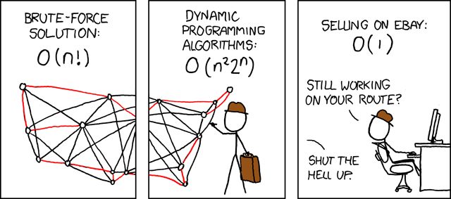
Modern TSP
From: http://xkcd.com/399/

Slide 8
The Complexity Zoo
The attempt to characterize the decidable languages by their complexity:
http://qwiki.stanford.edu/wiki/Complexity_Zoo
Notable ones:
P: by deterministic TM (algorithm) in polynomial time
  solution can be found in polynomial time (efficiently)
  tractable
  context-free (including regular) languages are in P
NP: by nondeterministic TM (algorithm) in polynomial time
  solution can be verified in polynomial time
NP-complete: as hard as any one in NP & in NP (hardest ones in NP)
  no efficient algorithm is known
  require non-trivial search, as in TSP
NP-hard: as hard as any one in NP (not necessarily in NP)
  L is NP-complete if it is in NP and it is NP-hard
  Intractable = not in P. But since it’s believed P ≠ NP, loosely intractable = NP hard = NP complete + not in NP
  If it’s proved that P = NP, then intractable = not in P = not in NP

Slide 9
Methodology
Characterizing problems as languages to be comparable
  SAT = {w : w is a wff in Boolean logic and w is satisfiable}
  only applies to decidable languages. nothing to say about H
  Including optimization problems
    TSP-DECIDE = {<G, cost> : <G> encodes an undirected graph with a positive distance attached to each of its edges and G contains a Hamiltonian circuit whose total cost is less than <cost>}.
All problems are decision problems
  requires at least enough time to write the solution
  By restricting our attention to decision problems, the length of the answer is not a factor
Encoding matters as complexity is w.r.t. problem size
  L is regular for one encoding, nonregular for another
  E.g., for integers, we should use any base other than 1
111111111111 vs 1100
111111111111111111111111111111 vs 11110
Notes:
H = {<M, w> : Turing machine M halts on input string w}
Encoding: section 3.2, an integer sum problem is regular for one encoding, non-regular for another

Slide 10
Measuring Time and Space Complexity
Model of computation: TM
timereq(M) is a function of n:
  If M is a deterministic
timereq(M) = f(n) = the maximum number of steps that M executes on any input of length n.
    If M is a nondeterministic
timereq(M) = f(n) = the number of steps on the longest path that M executes on any input of length n.
spacereq(M) is a function of n:
    If M is a deterministic
spacereq(M) = f(n) = the maximum number of tape squares that M reads on any input of length n.
    If M is a nondeterministic
spacereq(M) = f(n) = the maximum number of tape squares that M reads on any path that it executes on any input of length n.
Focus on worst-case performance
  Interested in upper bound
  Easy to determine
  Beware: could be quite different from average-case
  Good news: for most real problems, worst case is rare

Slide 11
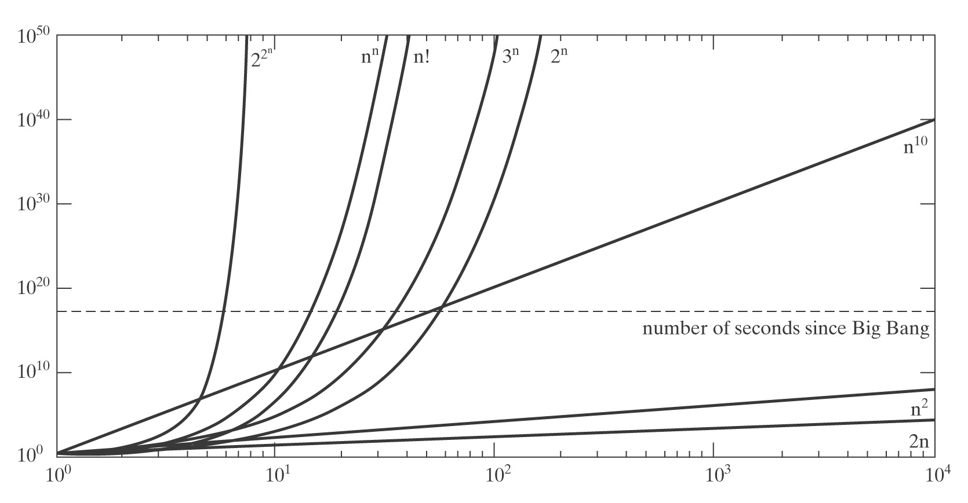
Growth Rates of Functions

Slide 12
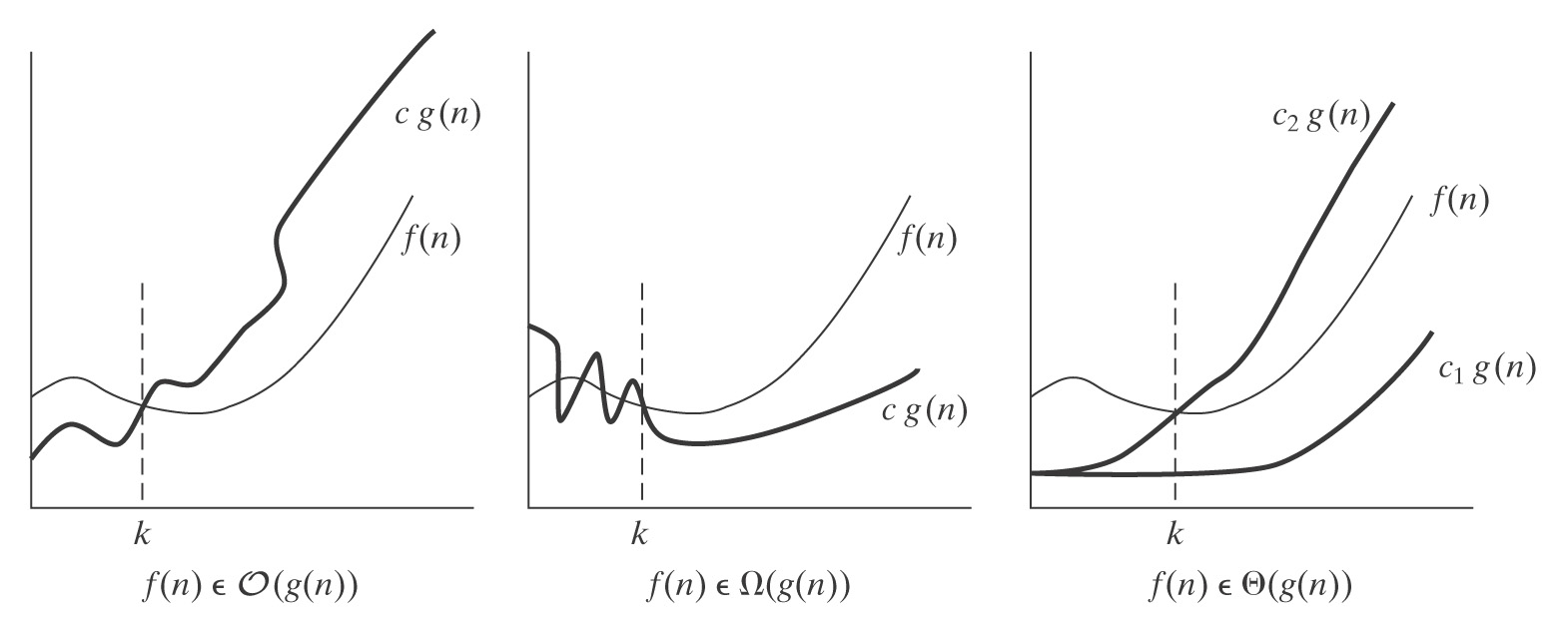
Asymptotic Dominance

Slide 13
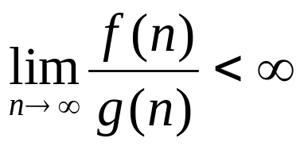
Asymptotic Dominance - O
f(n) ∈ O(g(n)) iff there exists a positive integer k and a
positive constant c such that:
∀n ≥ k (f(n) ≤ c g(n)).
Alternatively, if the limit exists:
Or, g grows at least as fast as f does.

Slide 14
Asymptotic Dominance - O
● n³ ∈ O(n³).
● n³ ∈ O(n⁴).
● 3n³ ∈ O(n³).
● n³ ∈ O(3^{n}).
● n³ ∈ O(n!).
● log n ∈ O( ).

Slide 15
Summarizing O
O(c) ⊆ O(log_{a} n) ⊆ O(n^{b}) ⊆ O(d^{n}) ⊆ O(n!)

Slide 16
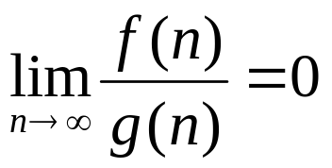
o
Asymptotic strong upper bound: f(n) ∈ o(g(n)) iff, for
every positive c, there exists a positive integer k such that:
∀n ≥ k (f(n) < c g(n)).
Alternatively, if the limit exists:
In this case, we’ll say that f is “little-oh” of g or that g grows
strictly faster than f does.

Slide 17
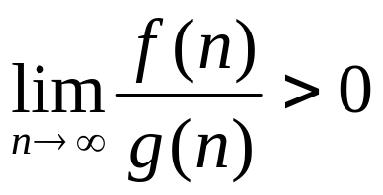
Ω
● Asymptotic lower bound: f(n) ∈ Ω(g(n)) iff there exists
a positive integer k and a positive constant c such that:
∀n ≥ k (f(n) ≥ c g(n)).
In other words, ignoring some number of small cases
(all those of size less than k), and ignoring some
constant factor c, f(n) is bounded from below by g(n).
Alternatively, if the limit exists:
In this case, we’ll say that f is “big-Omega” of g or that g
grows no faster than f.

Slide 18
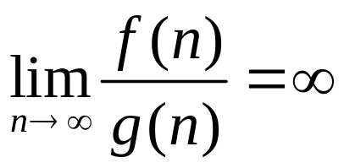
ω
● Asymptotic strong lower bound: f(n) ∈ ω(g(n))
iff, for every positive c, there exists a positive integer
k such that:
∀n ≥ k (f(n) > c g(n)).
Alternatively, if the required limit exists:
In this case, we’ll say that f is “little-omega” of g or that
g grows strictly slower than f does.

Slide 19
Θ
f(n) ∈ Θ(g(n)) iff there exists a positive integer k and
positive constants c₁, and c₂ such that:
∀n ≥ k (c₁ g(n) ≤ f(n) ≤ c₂ g(n))
Or: Or:
f(n) ∈ Θ(g(n)) iff: f(n) ∈ Θ(g(n)) iff:
f(n) ∈ O(g(n)), and f(n) ∈ O(g(n)), and
g(n) ∈ O(f(n)). f(n) ∈ Ω(g(n)).
Is n³ ∈ Θ(n³)?
Is n³ ∈ Θ(n⁴)?
Is n³ ∈ Θ(n⁵)?

Slide 20
Algorithmic Gaps
We’d like to show:
1. Upper bound: There exists an algorithm that decides L and that has complexity C₁.
2. Lower bound: Any algorithm that decides L must have complexity at least C₂.
3. C₁ = C₂.
If C₁ = C₂, we are done. Often, we’re not done.

Slide 21
Time-Space Tradeoffs - Search
Depth-first search: small space, big time
  potential problem: get stuck in one path
Breadth-first search: big space, small time
Iterative-deepening search: compromise
  depth-first on length 1 paths, length 2 paths and so on
  Space same as depth-first, time slightly worse than breath-first

Slide 22
Time Complexity Classes
Chapter 28

Slide 23
The Language Class P
  L ∈ P iff
  ● there exists some deterministic Turing machine M
  that decides L, and
  ● timereq(M) ∈ O(n^{k}) for some k.
  We’ll say that L is tractable iff it is in P.
To Show That a Language Is In P:
describe a one-tape, deterministic Turing machine.
state an algorithm that runs on a regular random-access computer.
  easier

Slide 24
Languages That Are in P
● Every regular language.
● Every context-free language since there exist
context-free parsing algorithms that run in O(n³) time.
● Others:
● A^{n}B^{n}C^{n}

Slide 25
The Language Class NP
Nondeterministic deciding:
L ∈ NP iff:
● there is some NDTM M that decides L, and
● timereq(M) ∈ O(n^{k}) for some k.
NDTM deciders: longest path is polynomial
s,abab
q₂,#abab q₁,abab
q₁,abab q₃,bbab

Slide 26
Deterministic Verifying
A Turing machine V is a verifier for a language L iff:
w ∈ L iff ∃c (<w, c> ∈ L(V)).
We’ll call c a certificate.
An alternative definition for the class NP:
L ∈ NP iff there exists a deterministic TM V such that:
● V is a verifier for L, and
● timereq(V) ∈ O(n^{k}) for some k.
L is in NP iff it has a polynomial verifier.
Can think of a nondeterministic algorithm as acting in two phases:
– guess a solution (certificate) from a finite number of possibilities
– verify whether it indeed solves the problem
• The verification phase takes polynomial time ⬄ problem is in NP

Slide 27
Proving That a Language is in NP
● Exhibit an NDTM to decide it in polynomial time.
● Exhibit a DTM to verify it in polynomial time

Slide 28
Example
● SAT = {w : w is a Boolean wff and w is satisfiable} is in NP.
F₁ = P ∧ Q ∧ ¬R ?
F₂ = P ∧ Q ∧ R ?
F₃ = P ∧ ¬P ?
F₄ = P ∧ (Q ∨ ¬R) ∧ ¬Q ?
SAT-decide(F₄) =
SAT-verify (<F₄, (P = True, Q = False, R = False)>) =

Slide 29
3-SAT
A literal is either a variable or a variable preceded by a single negation symbol.
A clause is either a single literal or the disjunction of two or more literals.
A wff is in conjunctive normal form (or CNF) iff it is either a single clause or the conjunction of two or more clauses.
A wff is in 3-conjunctive normal form (or 3-CNF) iff it is in conjunctive normal form and each clause contains exactly three literals.

Slide 30
3-SAT
 | 3-CNF | CNF
(P ∨ ¬Q ∨ R) | • | •
(P ∨ ¬Q ∨ R) ∧ (¬P ∨ Q ∨ ¬R) | • | •
P |  | •
(P ∨ ¬Q ∨ R ∨ S) ∧ (¬P ∨ ¬R) |  | •
P → Q
(P ∧ ¬Q ∧ R ∧ S) ∨ (¬P ∧ ¬R)
¬(P ∨ Q ∨ R)
Every wff can be converted to an equivalent wff in CNF.
● 3-SAT = { w : w is a wff in Boolean logic,
w is in 3-conjunctive normal form, and
w is satisfiable}.
Is 3-SAT in NP?

Slide 31
INDEPENDENT-SET
● INDEPENDENT-SET = {<G, k> : G is an undirected graph and G
contains an independent set of at least k vertices}.
An independent set is a set of vertices no two of which are
adjacent (i.e., connected by a single edge. So, in the following
graph, the circled vertices form an independent set:
In a scheduling program the vertices represent tasks and are connected by an edge if their corresponding tasks conflict. We can find the largest number of tasks that can be scheduled at the same time by finding the largest independent set in the task graph.

Slide 32
CLIQUE
● CLIQUE = {<G, k> : G is an undirected graph with vertices V and edges E, k is an integer, 1 ≤ k ≤ |V|, and G contains a k-clique}.
A clique in G is a subset of V where every pair of vertices in the clique is connected by some edge in E.
A k-clique is a clique that contains exactly k vertices.

Slide 33
Other Languages That Are in NP
Graph-based languages:
● TSP-DECIDE.
● HAMILTONIAN-PATH = {<G> : G is an undirected graph and G contains a Hamiltonian path}.
● HAMILTONIAN-CIRCUIT = {<G, s> : G is an undirected graph and G contains a Hamiltonian circuit}.

Slide 34
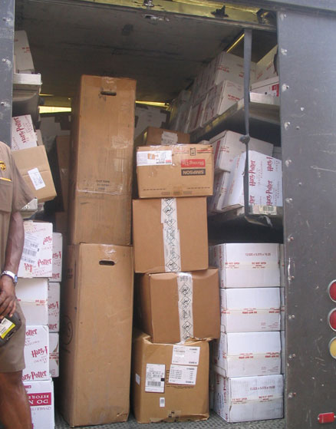

BIN-PACKING
BIN-PACKING = {<S, c, k> : S is a set of objects each of which has an associated size and it is possible to divide the objects so that they fit into k bins, each of which has size c}.
In three dimensions:
In two dimensions:

Slide 35
KNAPSACK
● KNAPSACK = {<S, v, c> : S is a set of objects each of which
has an associated cost and an associated value, v and c are
integers, and there exists some way of choosing elements of
S (duplicates allowed) such that the total cost of the chosen
objects is at most c and their total value is at least v}.
Notice that, if the cost of each item equals its value, then the
KNAPSACK problem becomes the SUBSET-SUM problem.
How to pack a knapsack with limited capacity in
such as way as to maximize the utility of the contents:
● A thief.
● A backpacker.
● Choosing ads for a campaign.
● What products should a company make?

Slide 36
P and NP
P: languages for which membership can be decided quickly
  Solvable by a DTM in poly-time
NP: languages for which membership can be verified quickly
    Solvable by a NDTM in poly-time
Greatest unsolved problem in theoretical computer science:
Is P = NP? The Millenium Prize
Two possibilities:
P
NP
P = NP
If P = NP, any polynomially verifiable problems would be polynomially decidable

Slide 37
P and NP: What We Know
PSPACE: L ∈ PSPACE iff there is some deterministic TM M that decides L, and spacereq(M) ∈ O(n^{k}) for some k.
  Solvable by a DTM in poly-space
NPSPACE: L ∈ NPSPACE iff there is some nondeterministic TM M that decides L, and spacereq(M) ∈ O(n^{k}) for some k.
  Solvable by a NDTM in poly-space
EXPTIME: L ∈ EXPTIME iff there is some deterministic TM M that decides L, and timereq(M) ∈ O(2^{(nk)}) for some k.
  Solvable by a DTM in exponential-space
Here are some things we know:
P ⊆ NP ⊆ PSPACE ⊆ NPSPACE ⊆ EXPTIME
P ≠ EXPTIME
So there exist decidable but intractable problems
So at least one of the inclusions shown above must be proper
Generally assumed all of them are, but no proofs
Some problems are even harder than EXPTIME-complete problems.

Slide 38
P and NP
If a Turing Machine were to guess,
With less computational stress,
Polynomially check
That its guess was not dreck,
Thus avoiding enumerative mess.
The machine would then certainly be
Witness to a language in NP.
By guessing, we shirk
Exponential-time work.
Nondeterminism can do search for free.
Cook and Levin, I am now recalling
Found a language L that's really galling:
If there is time compaction
To prove satisfaction
Then P=NP--appalling!
It is computational fate
To encounter such barriers we hate.
Yet there are computations
To find estimations
Within factors approximate.
Notes:
Martin Cohn
Harry Mairson
Computer Science Department
Brandeis University

Slide 39
Mapping Reduction
A mapping reduction R from L_{old} to L_{new} is a
Turing machine that
implements some computable function f with the property that:
∀x (x ∈ L_{old} ↔ f(x) ∈ L_{new} )
If L_{old} ≤ L_{new} and M decides L_{new} , then:
C(x) = M(R(x)) will decide L_{old}.

Slide 40
Polynomial Reducibility
If R is deterministic polynomial then:
L_{old} ≤_{P} L_{new}
And, whenever such an R exists:
● L_{old} must be in P if L_{new} is: if L_{new} is in P then there exists some deterministic, polynomial-time Turing machine M that decides it. So M(R(x)) is also a deterministic, polynomial-time Turing machine and it decides L_{old}.
● L_{old} must be in NP if L_{new} is: if L_{new} is in NP then there exists some nondeterministic, polynomial-time Turing machine M that decides it. So M(R(x)) is also a nondeterministic, polynomial-time Turing machine and it decides L_{old}.

Slide 41
3-SAT and INDEPENDENT-SET
3-SAT ≤_{P} INDEPENDENT-SET.
Strings in 3-SAT describe formulas that contain literals and
clauses.
(P ∨ Q ∨ ¬R) ∧ (R ∨ ¬S ∨ Q)
Strings in INDEPENDENT-SET describe graphs that contain
vertices and edges.
101/1/11/11/10/10/100/100/101/11/101

Slide 42
Gadgets
A gadget is a structure in the target language that mimics
the role of a corresponding structure in the source language.
Example: 3-SAT ≤_{P} INDEPENDENT-SET.
So we need:
a gadget that looks like a graph but that mimics a literal, and
a gadget that looks like a graph but that mimics a clause.

Slide 43
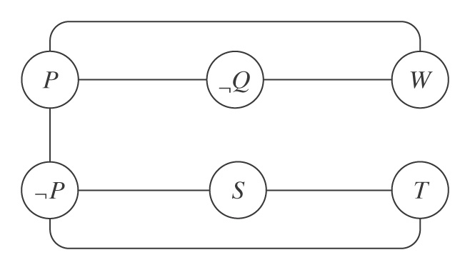
3-SAT ≤_{P} INDEPENDENT-SET
R(<f: Boolean formula with k clauses>) =
1. Build a graph G by doing the following:
  1.1. Create one vertex for each instance of each literal in f. (literal gadget)
  1.2. Create an edge between each pair of vertices for symbols in the same clause. (clause gadget)
  1.3. Create an edge between each pair of vertices for
  complementary literals.
2. Return <G, k>.
(P ∨ ¬Q ∨ W) ∧ (¬P ∨ S ∨ T):

Slide 44
R is Correct
Show: f ∈ 3-SAT iff R(<f>) ∈ INDEPENDENT-SET
by showing:
● f ∈ 3-SAT → R(<f>) ∈ INDEPENDENT-SET
● R(<f>) ∈ INDEPENDENT-SET → f ∈ 3-SAT

Slide 45
One Direction
f ∈ 3-SAT → R(<f>) ∈ INDEPENDENT-SET:
There is a satisfying assignment A to the symbols in f.
So G contains an independent set S of size k, built by:
1. From each clause gadget choose one literal that is made
positive by A.
2. Add the vertex corresponding to that literal to S.
S will contain exactly k vertices and is an independent set:
● No two vertices come from the same clause so step 1.2
could not have created an edge between them.
● No two vertices correspond to complimentary literals so step
1.3 could not have created an edge between them.

Slide 46
The Other Direction
● R(<f>) ∈ INDEPENDENT-SET.
● So the graph G that R builds contains an independent set S of size k.
● We prove that there is some satisfying assignment A for f:
No two vertices in S come from the same clause gadget. Since S
contains at least k vertices, no two are from the same clause, and f
contains k clauses, S must contain one vertex from each clause.
Build A as follows:
1. Assign True to each literal that corresponds to a vertex in S.
2. Assign arbitrary values to all other literals.
Since each clause will contain at least one literal whose value is
True, the value of f will be True.

Slide 47
Why Do Reduction?
Would we ever choose to solve 3-SAT by reducing it
to INDEPENDENT-SET?
The way we use reduction is: known 3-SAT (L_{old} ) is NP-complete, show INDEPENDENT-SET (L_{new}) is NP-complete.

Slide 48
NP-Completeness
Sections 28.5, 28.6

Slide 49
NP-Completeness
A language L might have these properties:
L is in NP.
Every language in NP is deterministic, polynomial-time reducible to L.
L is NP-hard iff it possesses property 2.
An NP-hard language is at least as hard as any other language in NP. It may not be in NP.
L is NP-complete iff it possesses both property 1 and property 2.
All NP-complete languages can be viewed as being equivalently hard, the hardest ones in NP.

Slide 50
NP-Completeness
The class of NP-complete is important, many of its members, like TSP, have substantial practical significance.
Two possibilities:
NP
P
NP-complete
P = NP
NP-complete

Slide 51
Showing that L_{new} is NP-Complete
How about: take a list of known NP languages and crank out the reductions?
NPL₁ ≤_{P} L_{new}
NPL₂ ≤_{P} L_{new}
NPL₃ ≤_{P} L_{new}
…
infinite number of NP languages

Slide 52
Showing that L_{new} is NP-Complete
Suppose we had one NP-complete language L_{old} :
NPL₁ NPL₂ NPL₃ NPL₄ NPL...
L_{old}
L_{new}
Theorem:
If: L_{old} is NP-complete
L_{old} ≤_{P} L_{new}
L_{new} is in NP
Then L_{new} is also NP-complete
So we need a first NP-complete language !

Slide 53
Proving that L_{new} is NP-Complete
Theorem: If L_{old} is NP-complete, L_{old} ≤_{P} L_{new}, and L_{new} is in NP, then L_{new} is also NP-complete.
Proof: If L_{old} is NP-complete then every other NP language is deterministic, polynomial-time reducible to it. So let L be any NP language and let R_{L} be the Turing machine that reduces L to L_{old}. If L_{old} ≤_{P} L_{new}, let R₂ be the Turing machine that implements that reduction. Then L can be deterministic, polynomial-time reduced to L_{new} by first applying R_{L} and then applying R₂. Since L_{new} is in NP and every other language in NP is deterministic, polynomial-time reducible to it, it is NP-complete.

Slide 54
The Cook-Levin Theorem
Define: SAT = {w : w is a wff in Boolean logic and
w is satisfiable}
Theorem: SAT is NP-complete.
Proof:
  SAT is in NP.
  SAT is NP-hard.

Slide 55
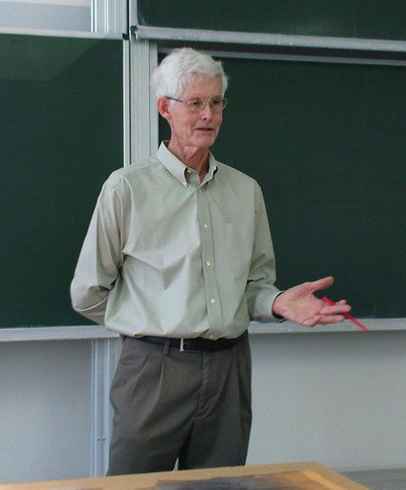
Stephen Cook
Bachelor, U of Michigan
Ph.D. in math, Harvard, 1966
Taught at Berkley, now at Toronto
Formalized notion of NP-completeness
Turing award in 1982, citation reads:
For his advancement of our understanding of the complexity of computation in a significant and profound way. His seminal paper, The Complexity of Theorem Proving Procedures, presented at the 1971 ACM SIGACT Symposium on the Theory of Computing, laid the foundations for the theory of NP-Completeness. The ensuring exploration of the boundaries and nature of NP-complete class of problems has been one of the most active and important research activities in computer science for the last decade.
1939 -
From 1966 to 1970, Assistant Professor at Berkley, math department, which infamously denied him tenure. In a speech celebrating the 30th anniversary of the Berkeley EECS department, fellow Turing Award winner and Berkeley professor Richard Karp said that, "It is to our everlasting shame that we were unable to persuade the math department to give him tenure. Perhaps they would have done so if he had published his proof of the NP-completeness of satisfiability a little earlier.”
Notes:
Phil Bernstein

Slide 56
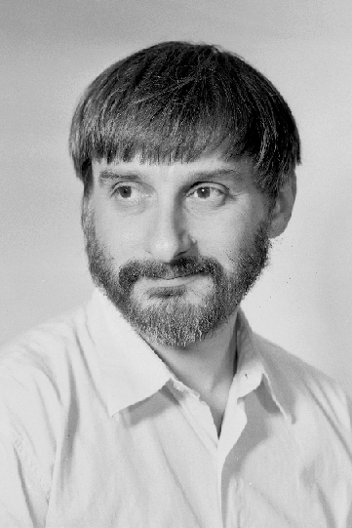
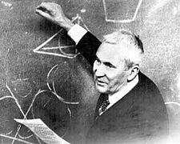
Leonid Levin
1st Ph.D, Moscow University, 1972
  with Andrey Kolmogorov
2nd Ph.D, MIT, 1979
Now professor at BU
Levin's journal article on the theorem was published in 1973; he had lectured on the ideas in it for some years before that time, though complete formal writing of the results took place after Cook's publication.
Andrey Kolmogorov (1903 – 1987): Soviet Russian mathematician, preeminent in the 20th century, who advanced various scientific fields:
  probability theory
  topology
  intuitionistic logic
  turbulence
  classical mechanics
  computational complexity
1948 -
Notes:
Flavia, ballack, world cup, we are talking …
http://www.cs.bu.edu/~lnd/
Strong characteristics, Washington U talk at UW-madison
After him, become the 2nd worst

Slide 57
SAT is NP-Hard
Let L be any language in NP.
Let M be one of the NDTMs that decides L.
Define an algorithm that, given M, constructs a reduction R with the property that:
w ∈ L iff R(w) ∈ SAT.
R takes a string w and returns a Boolean wff that is satisfiable iff w ∈ L.

Slide 58
NP-Complete Languages
INDEPENDENT-SET = {<G, k> : G is an undirected graph and G contains an independent set of at least k vertices}.
CLIQUE = {<G, k> : G is an undirected graph with vertices V and edges E, k is an integer, 1 ≤ k ≤ |V|, and G contains a k-clique}.

Slide 59
NP-Complete Languages
SUBSET-SUM = {<S, k> : S is a multiset of integers, k is an integer, and there exists some subset of S whose elements sum to k}.
SET-PARTITION = {<S> : S is a multiset of objects each of which has an associated cost and there exists a way to divide S into two subsets, A and S - A, such that the sum of the costs of the elements in A equals the sum of the costs of the elements in S - A}.
TSP-DECIDE.
HAMILTONIAN-PATH = {<G> : G is an undirected graph and G contains a Hamiltonian path}.
HAMILTONIAN-CIRCUIT = {<G> : G is an undirected graph and G contains a Hamiltonian circuit}.
KNAPSACK = {<S, v, c> : S is a set of objects each of which has an associated cost and an associated value, v and c are integers, and there exists some way of choosing elements of S (duplicates allowed) such that the total cost of the chosen objects is at most c and their total value is at least v}.
BIN-PACKING = {<S, c, k> : S is a set of objects each of which has an associated size and it is possible to divide the objects so that they fit into k bins, each of which has size c}.

Slide 60
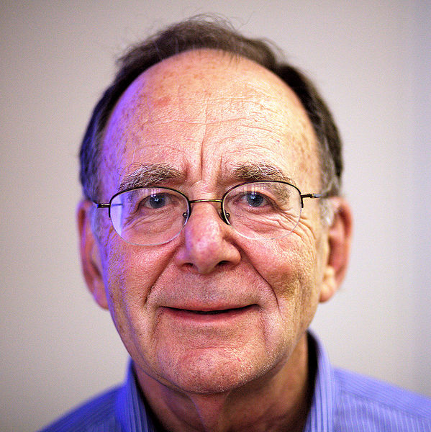
Richard Karp
Bachelor, U of Michigan
Ph.D. in applied math, Harvard, 1959
Now at Berkley
1972, published a landmark paper, "Reducibility Among Combinatorial Problems", proved 21 problems to be NP-complete
Standardized proving methodology
National medal of science
Turing award in 1985, citation reads:
1935 -
For his continuing contributions to the theory of algorithms including the development of efficient algorithms for network flow and other combinatorial optimization problems, the identification of polynomial-time computability with the intuitive notion of algorithmic efficiency, and, most notably, contributions to the theory of NP-completeness. Karp introduced the now standard methodology for proving problems to be NP-complete which has led to the identification of many theoretical and practical problems as being computationally difficult.

Slide 61
Strategy for Proving NP-completeness of L_{new}
• Show that L_{new} belongs to NP
  Exhibit an NDTM to decide it in polynomial time.
  Or, equivalently,
  Exhibit a DTM to verify it in polynomial time
  This establishes an upper bound on the complexity of L_{new}
• Show that L_{new} is NP-hard by finding another NP-hard language L_{old} such that
L_{old} ≤_{P} L_{new}
  This establishes a lower bound on the complexity of L_{new}

Slide 62
Proving 3-SAT is NP-Complete
Define: 3-SAT = {<w> : w is a wff in Boolean logic, w is in 3-conjunctive normal form and w is satisfiable}.
(P ∨ R ∨ ¬T) ∧ (S ∨ ¬R ∨ W)
Theorem: 3-SAT is NP-complete.
Proof: We have shown that 3-SAT is in NP.
What about NP-hard?

Slide 63
3-SAT
First we try a reduction from SAT:
R(w: wff of Boolean logic) =
Use conjunctiveBoolean to construct w′, where w′ is in conjunctive normal form and w′ is equivalent to w.
Use 3-conjunctiveBoolean to construct w′′, where w′′ is in 3-conjunctive normal form and w′′ is satisfiable iff w′ is.
Return w′′.
Does R run in polynomial time?

Slide 64
Converting to CNF
((p ∧ q) ∨ (r ∧ s)) ∨ (t ∧ v) ∨ (w ∧ x))
((p ∨ r) ∧ (q ∨ r) ∧ (p ∨ s) ∧ (q ∨ s)) ∨

Slide 65
3-SAT is NP-Hard
Idea 1: Retain the idea of reducing SAT to 3-SAT.
For R to be a reduction from SAT to 3-SAT, it is sufficient to assure that w′ is satisifiable iff w is.
There exists a polynomial-time algorithm that constructs, from any wff w, a w′ that meets that requirement.
If we replace step one of R with that algorithm, R is a polynomial-time reduction from SAT to 3-SAT.
So 3-SAT is NP-hard.

Slide 66
3-SAT is NP-Hard
Idea 2: Prove that 3-SAT is NP-hard directly.
It is possible to modify the reduction R that proves the Cook-Levin Theorem so that it constructs a formula in conjunctive normal form.
R will still run in polynomial time.
Once R has constructed a conjunctive normal form formula w, we can use 3-conjunctiveBoolean to construct w′, where w′ is in 3-conjunctive normal form and w′ is satisfiable iff w is.
This composition of 3-conjunctiveBoolean with R shows that any NP language can be reduced to 3-SAT.
So 3-SAT is NP-hard.

Slide 67
Proving INDEPENDENT-SET is NP-Complete
Theorem: INDEPENDENT-SET is NP-complete.
INDEPENDENT-SET is in NP:
Ver(<G, k, c>) =
1. Check that the number of vertices in c is at least k and no more than |V|. If it is not, reject.
2. For each vertex v in c:
For each edge e in E that has v as one endpoint:
Check that the other endpoint of e is not in c.
Timereq(Ver) ∈ O(|c|⋅|E|⋅|c|).
|c| and |E| are polynomial in |<G, k>|.
So Ver runs in polynomial time.
INDEPENDENT-SET is NP-hard:
3-SAT ≤_{P} INDEPENDENT-SET.
SAT
3-SAT
INDEPENDENT-SET

Slide 68
Example Reductions
SAT
3-SAT
INDEPENDENT-SET
SAT
3-SAT
HAMILTONIAN-CIRCUIT
TSP

Slide 69
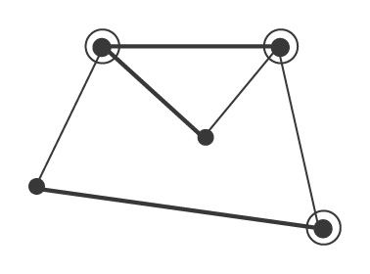
VERTEX-COVER
VERTEX-COVER = {<G, k>: G is an undirected graph and there exists a vertex cover of G that contains at most k vertices}.
A vertex cover C of a graph G = (V, E) is a subset of V such that every edge in E touches at least one of the vertices in C.
To be able to test every link in a network, it suffices to place monitors at a set of vertices that form a vertex cover of the network.

Slide 70
VERTEX-COVER
Theorem: VERTEX-COVER is NP-complete.
Proof: We must prove:
  VERTEX-COVER is in NP, and
  VERTEX-COVER is NP-hard.

Slide 71
VERTEX-COVER is in NP
Proof: Ver(<G, k, c>) =
1. Check that the number of vertices in c is at most
min(k, |V|). If not, reject.
2. For each vertex v in c do:
Find all edges in E that have v as one endpoint
and mark each such edge.
3. Make one final pass through E and check whether
every edge is marked. If all of them are, accept;
otherwise reject.
Timereq(Ver) ∈ O(|c|⋅|E|).
Both |c| and |E| are polynomial in |<G, k>|. So Ver runs in polynomial time.

Slide 72
VERTEX-COVER is NP-Hard
Proof: By reduction from 3-SAT:
Given a wff f, R will exploit two kinds of gadgets:
A variable gadget: For each variable x in f, R will build a simple graph with two vertices and one edge between them. Label one of the vertices x and the other one ¬x.
A clause gadget: For each clause c in f, R will build a graph with three vertices, one for each literal in c. There will be an edge between each pair of vertices in this graph.
Then R will build an edge from every vertex in a clause gadget to the vertex of the variable gadget with the same label.

Slide 73
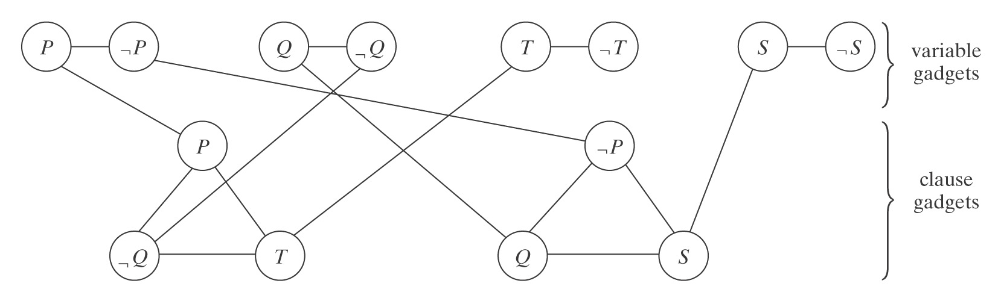
VERTEX-COVER
(P ∨ ¬Q ∨ T) ∧ (¬P ∨ Q ∨ S)

Slide 74
VERTEX-COVER
R(<f>) =
Build a graph G as described above.
Let k = v + 2c.
Return <G, k>.
R runs in polynomial time. To show that it is correct, we must show that:
<f> ∈ 3-SAT iff R(<f>) ∈ VERTEX-COVER.

Slide 75
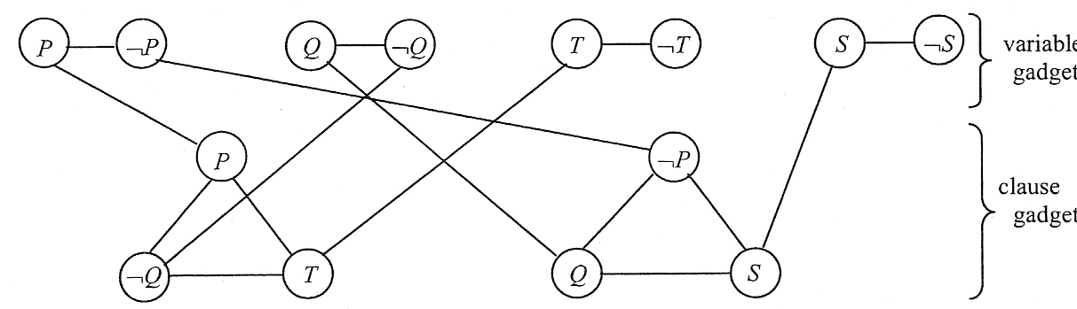
VERTEX-COVER
<f> ∈ 3-SAT → R(<f>) ∈ VERTEX-COVER: There exists a satisfying assignment A for f. G contains a vertex cover C of size k:
From each variable gadget, add to C the vertex that corresponds to the literal that is true in A.
Since A is a satisfying assignment, there must exist at least one true literal in each clause. Pick one and put the vertices corresponding to the other two into C.
C contains exactly k vertices. And it is a cover of G:
Notes:
C is a cover of G because:
One vertex from every variable gadget is in C so all the edges that are internal to the variable gadgets are covered.
Two vertices from every clause gadget are in C so all the edges that are internal to the clause gadgets are covered.
All the vertices that connect variable gadgets to clause gadgets are covered because, for each clause gadget:
Two of the three emerging edges are covered by the two clause gadget vertices in C.
The other one must be connected to a variable gadget vertex that corresponds to a true literal, so that vertex is in C.

Slide 76
VERTEX-COVER
R(<f>) ∈ VERTEX-COVER → <f> ∈ 3-SAT: The graph G that R builds contains a vertex cover C of size k. C must:
Contain at least one vertex from each variable gadget in order to cover the internal edge in the variable gadget.
Contain at least two vertices from each clause gadget in order to cover all three internal edges in the clause gadget.
Satisfying those two requirements uses up all k = v + 2c vertices, so the vertices we have just described are the only vertices in C.
Notes:
C is a cover of G because:
One vertex from every variable gadget is in C so all the edges that are internal to the variable gadgets are covered.
Two vertices from every clause gadget are in C so all the edges that are internal to the clause gadgets are covered.
All the vertices that connect variable gadgets to clause gadgets are covered because, for each clause gadget:
Two of the three emerging edges are covered by the two clause gadget vertices in C.
The other one must be connected to a variable gadget vertex that corresponds to a true literal, so that vertex is in C.

Slide 77
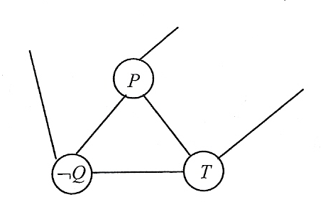
VERTEX-COVER
We can use C to show that there exists some satisfying assignment A for f.
To build A, assign the value True to each literal that is the label for one of the vertices of C that comes from a variable gadget.
A is a satisfying assignment for f iff it assigns the value True to at least one literal in each of f’s clauses. A must do that:
Notes:
Since C is a cover for G, all six of the edges that connect to vertices in this gadget must be covered. But we know that only two of the vertices in the gadget are in C. They can cover the three internal edges. But the three edges that connect to the variable gadgets must also be covered. Only two can be covered by a vertex in the clause gadget. The other one must be covered by its other endpoint, which is in some variable gadget. So each clause is connected to some literal whose corresponding vertex is in C. We made each such literal True in A. So A assigns the value True to at least one literal in each clause. Thus it is a satisfying assignment for f.

Slide 78
Small Differences Matter
Circuit problems
SAT problems
Path problems
Covering problems
Map coloring problems
Linear programming problems
Diophantine equation problems

Slide 79
Two Similar Circuit Problems
EULERIAN-CIRCUIT, in which we check that there is a circuit that visits every edge exactly once, is in P.
HAMILTONIAN-CIRCUIT, in which we check that there is a circuit that visits every vertex exactly once, is NP-complete.

Slide 80
Two Similar SAT Problems
2-SAT = {<w> : w is a wff in Boolean logic, w is in 2-conjunctive normal form and w is satisfiable} is in P.
    (¬P ∨ R) ∧ (S ∨ ¬T)
3-SAT = {<w> : w is a wff in Boolean logic, w is in 3-conjunctive normal form and w is satisfiable} is NP-complete.
    (¬P ∨ R ∨ T) ∧ (S ∨ ¬T ∨ ¬W)

Slide 81
Two Similar Path Problems
SHORTEST-PATH = {<G, u, v, k>: G is an undirected graph, u and v are vertices in G, k ≥ 0, and there exists a path from u to v whose length is at most k} is in P.
LONGEST-PATH = {<G, u, v, k>: G is an undirected graph, u and v are vertices in G, k ≥ 0, and there exists a path with no repeated edges from u to v whose length is at least k} is NP-complete.

Slide 82
Two Similar Path Problems
shortest-path(G = (V, E), u , v: vertices, k) =
Mark u.
For i = 1 to min(k, |E|) do:
  For each marked vertex n do:
    For each edge from n to some other vertex m do:
      Mark m.
If v is marked then accept. Else reject.
Shortest-path runs in O(|<G>|³) time.

Slide 83
Two Similar Covering Problems
An edge cover C of a graph G is a subset of the edges of G with the property that every vertex of G is an endpoint of one of the edges in C.
A vertex cover C of a graph G is a subset of the vertices of G with the property that every edge of G touches one of the vertices in C.

Slide 84
Two Similar Covering Problems
EDGE-COVER = {<G, k>: G is an undirected graph and there exists an edge cover of G that contains at most k edges} is in P.
VERTEX-COVER = {<G, k>: G is an undirected graph and there exists a vertex cover of G that contains at most k vertices} is NP-complete.

Slide 85
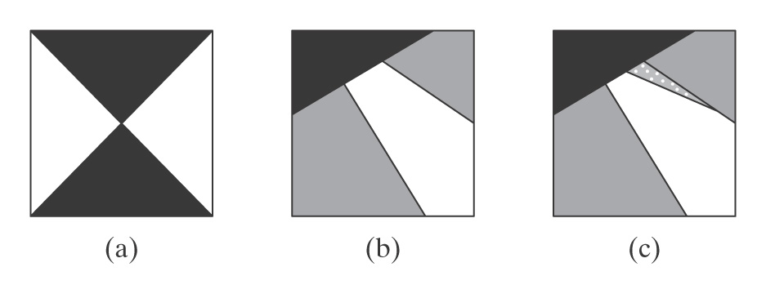
Three Similar Coloring Problems
Color a planar map so that no two adjacent regions (countries, states, or whatever) have the same color.
How many colors are required?

Slide 86
Three Similar Coloring Problems
2-COLORABLE = {<m> : m can be colored with 2 colors}.
3-COLORABLE = {<m> : m can be colored with 3 colors}.
4-COLORABLE = {<m> : m can be colored with 4 colors}.

Slide 87
Three Similar Coloring Problems
2-COLORABLE = {<m> : m can be colored with 2 colors}
  A map is 2-colorable iff it does not contain any point that is the junction of an odd number of regions. In P
3-COLORABLE = {<m> : m can be colored with 3 colors}.
  THREE-COLORABLE is NP-complete.
4-COLORABLE = {<m> : m can be colored with 4 colors}.
  in P

Slide 88
Chromatic Number
The chromatic number of a graph is the smallest number of colors required to color its vertices, subject to the constraint that no two adjacent vertices may be assigned the same color.
CHROMATIC-NUMBER = {<G, k> : G is an undirected graph whose chromatic number is no more than k}.
CHROMATIC-NUMBER is NP-complete.

Slide 89
Two Similar Linear Programming Problems
LINEAR-PROGRAMMING = {<a set of linear inequalities Ax ≤ b> : there exists a rational vector X that satisfies all of the inequalities} is in P.
INTEGER-PROGRAMMING = {<a set of linear inequalities Ax ≤ b> : there exists an integer vector X that satisfies all of the inequalities} is NP-complete.

